Slide 1
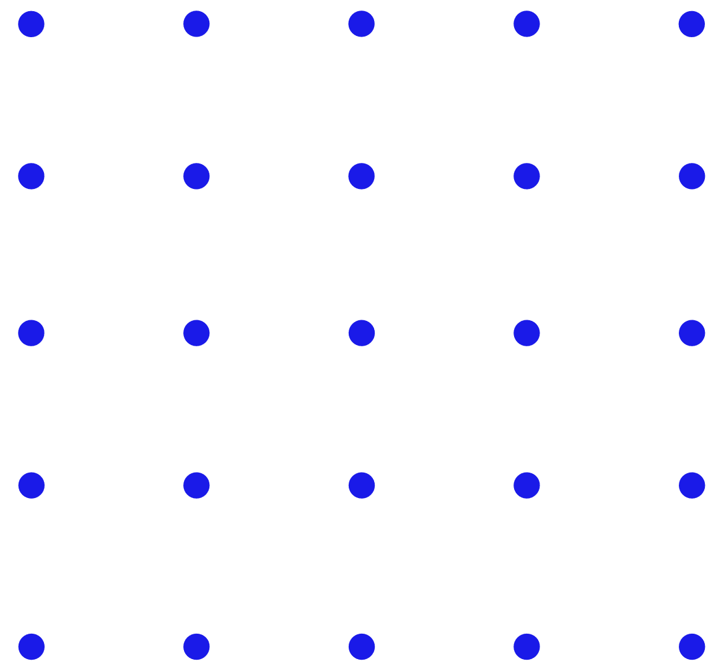
CSS Floats
By: Dalia Ihab

Slide 2


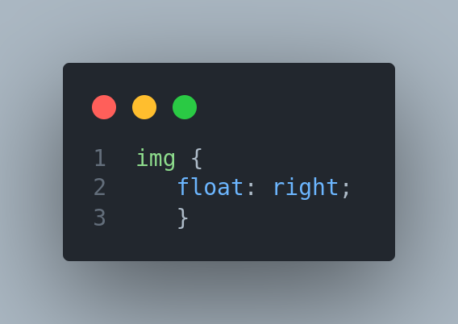
CSS Floats
The CSS float property is a positioning property. It is used to push an element to the left or right, allowing other element to wrap around it. It is generally used with images and layouts.
Notes:
https://www.javatpoint.com/css-float

Slide 3
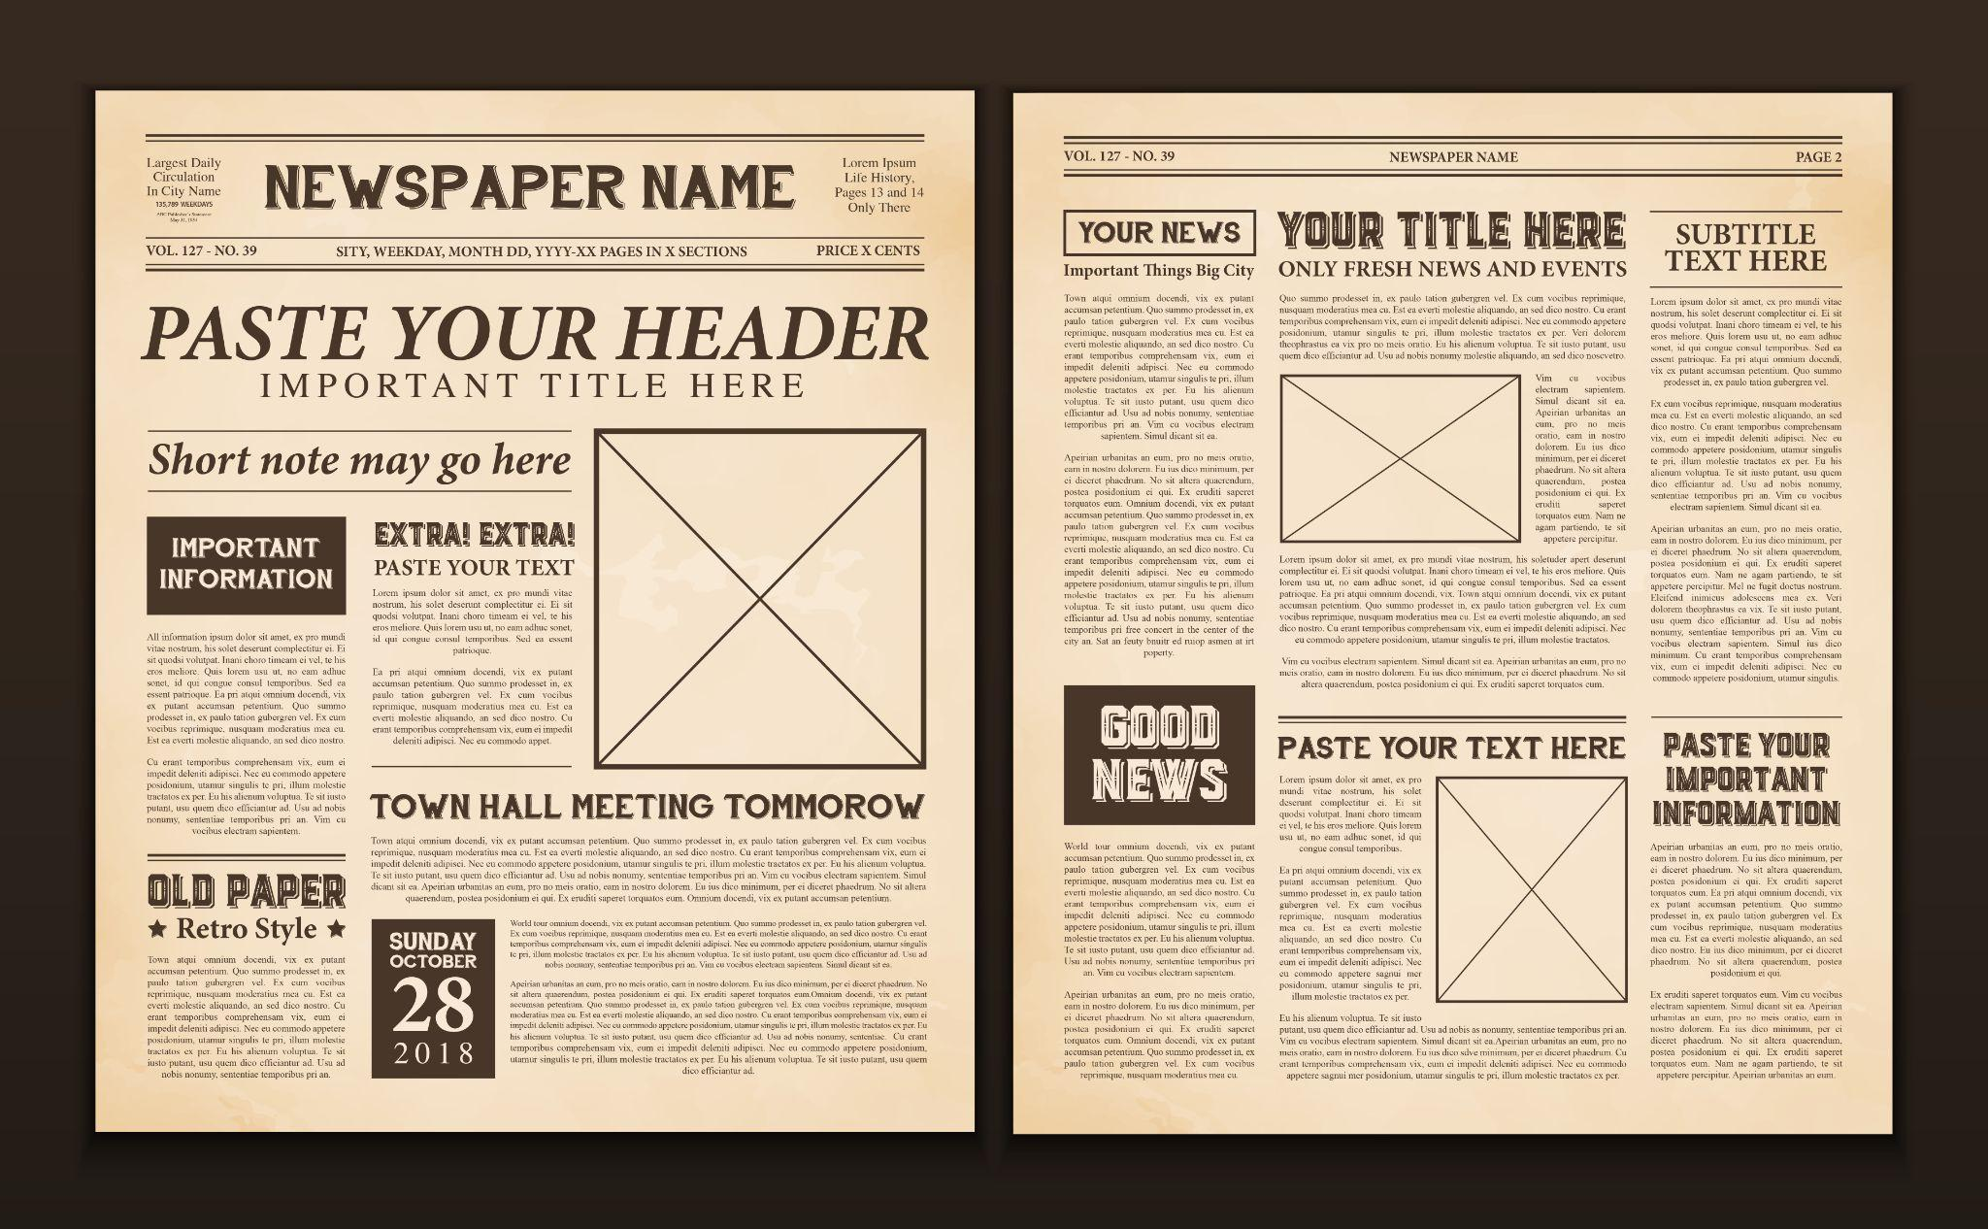

Slide 4
How it works
A floated element may be moved as far to the left or the right as possible. Simply, it means that a floated element can display at extreme left or extreme right.
The elements after the floating element will flow around it.

Slide 5
How it works
The elements before the floating element will not be affected.
If the image floated to the right, the texts flow around it, to the left and if the image floated to the left, the text flows around it, to the right.

Slide 6
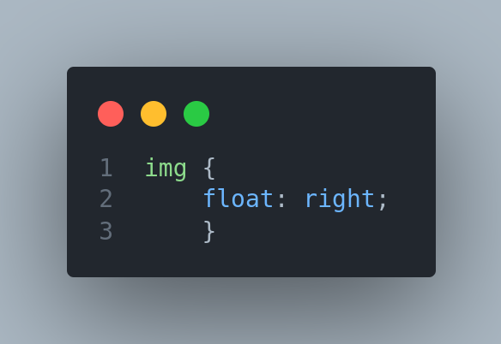
Clear Property
The clear property is used to avoid elements after the floating elements which flow around it.

Slide 7


Next
Javascript

